Slide 1
Open Sesame
Micheal Hatch & Phillip Vickers
Abstract: A hands free car door opening App. This App allows for your car door to open or close without using your door handle.

Slide 2
AGENDA
Introduction
Primary goals
Schedule
Hardware
Architecture and Design
Website
Live Demonstration

Slide 3
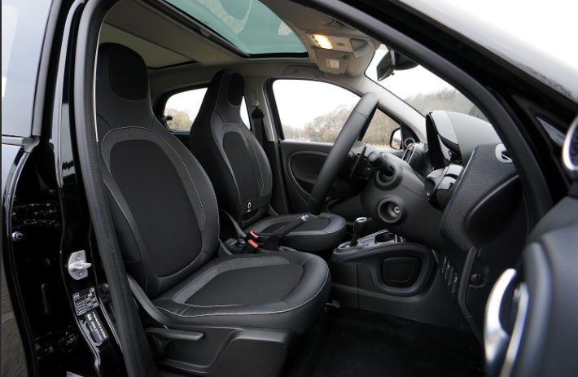
INTRODUCTION
How many times have you wished you had an extra hand when getting into your car? Well, wish no longer with Open Sesame. A voice activated App that opens and closes your car door for you.

Slide 4

PRIMARY GOALS
Hands Free Operation
Communication between App and Vehicle
Safety Features

Slide 5
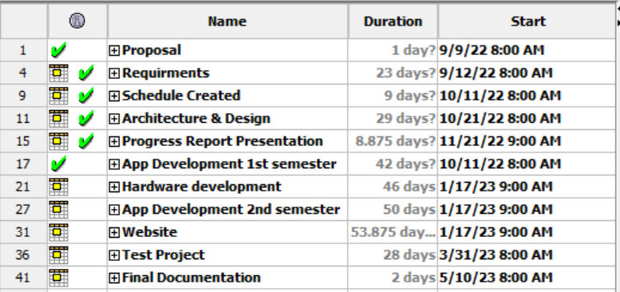
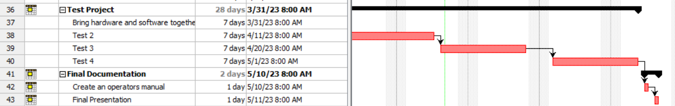
Schedule
Gantt Chart kept us on track.
Created a clear picture for the team to follow.
All tasks were completed on time.

Slide 6
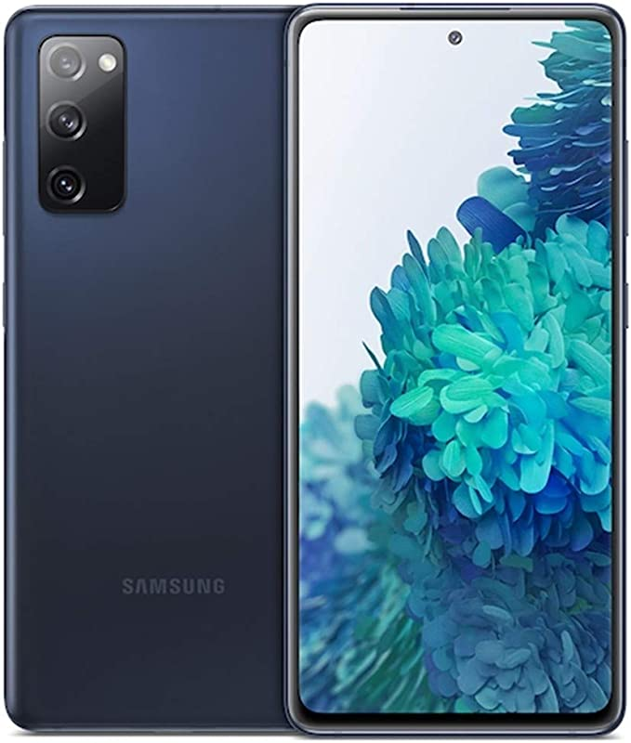
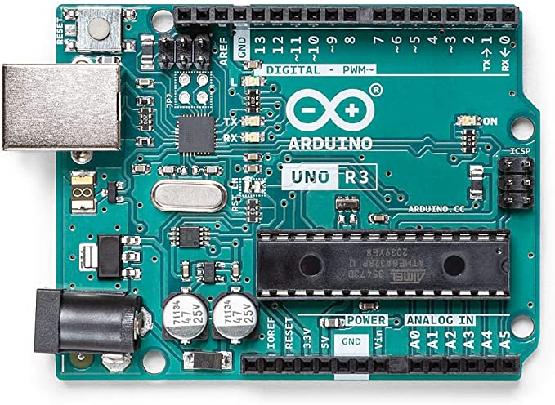
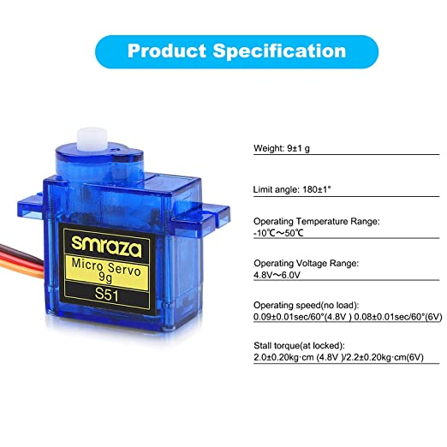
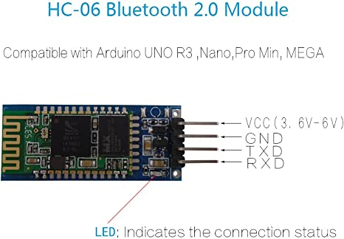
System components
Android Phone
Arduino Uno
4 Servo Motors

Slide 7
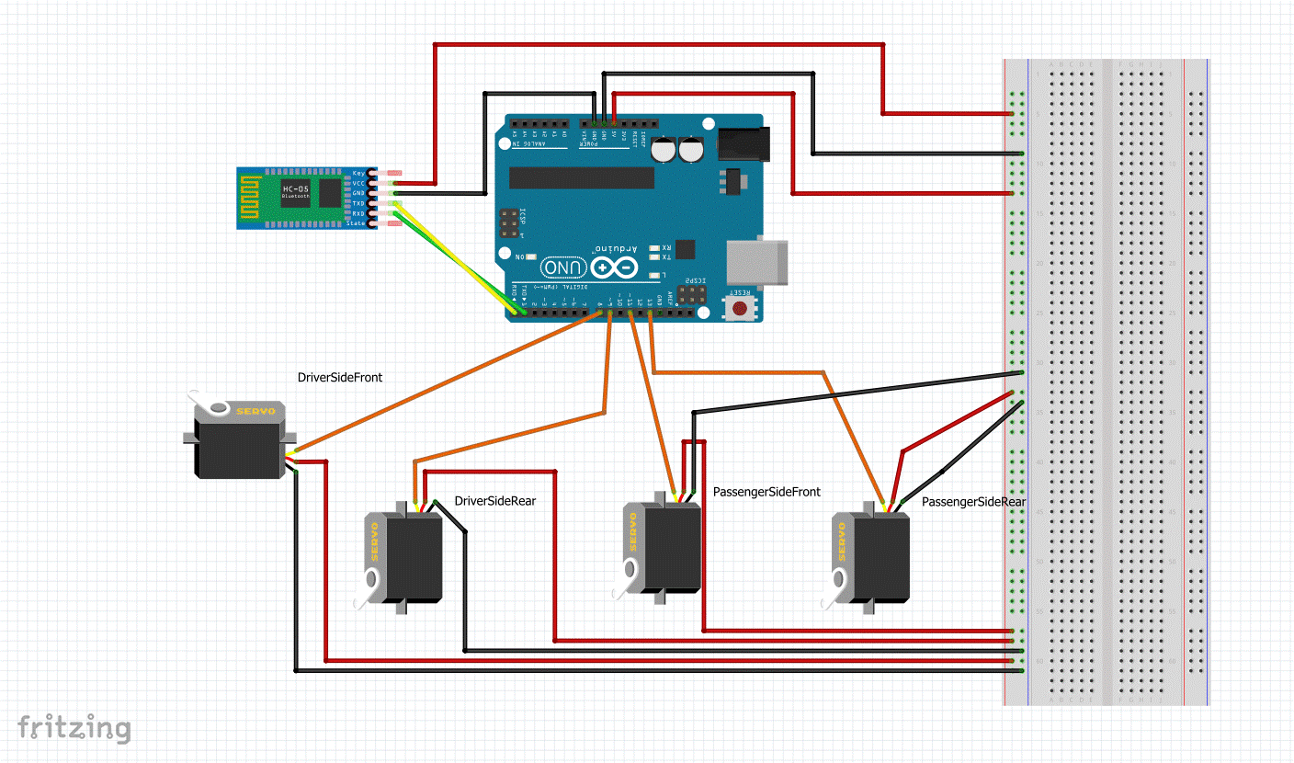
Original Hardware System
Arduino Uno
4 Servo motors
HC-06 Bluetooth module

Slide 8
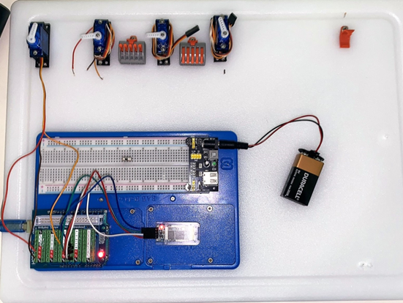
Started prototyping

Slide 9
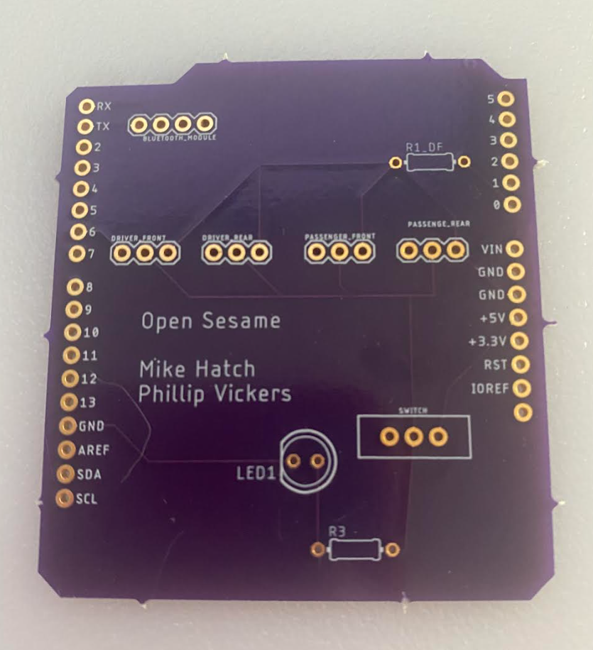
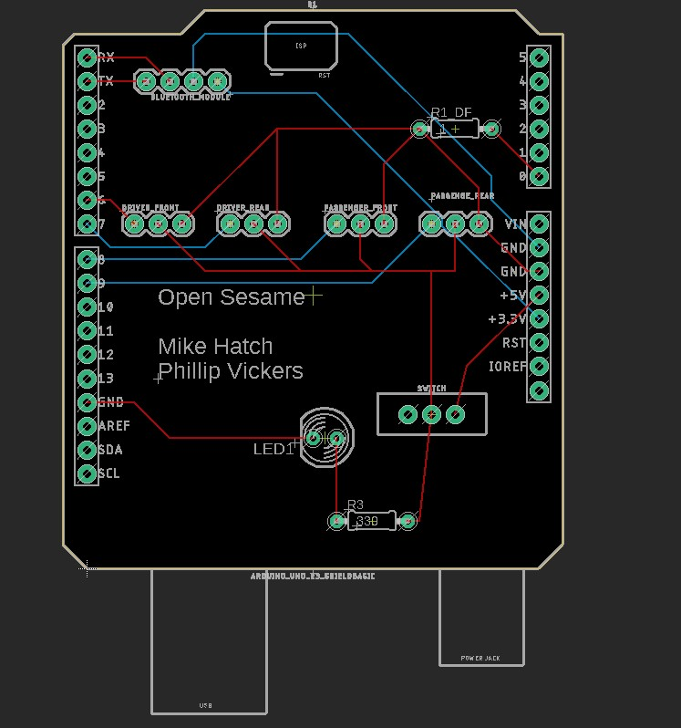
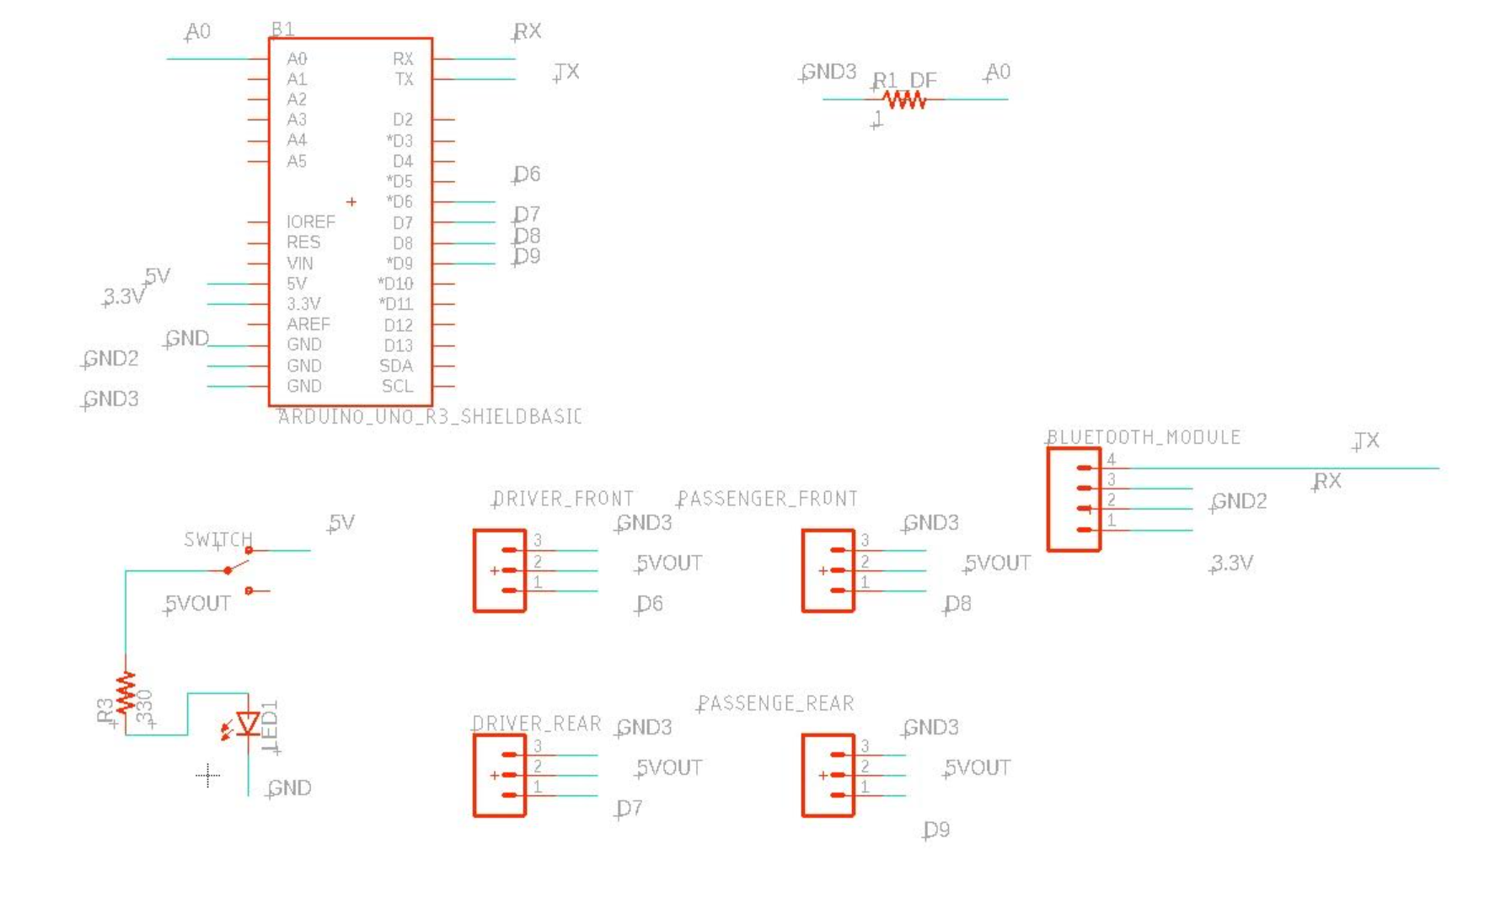
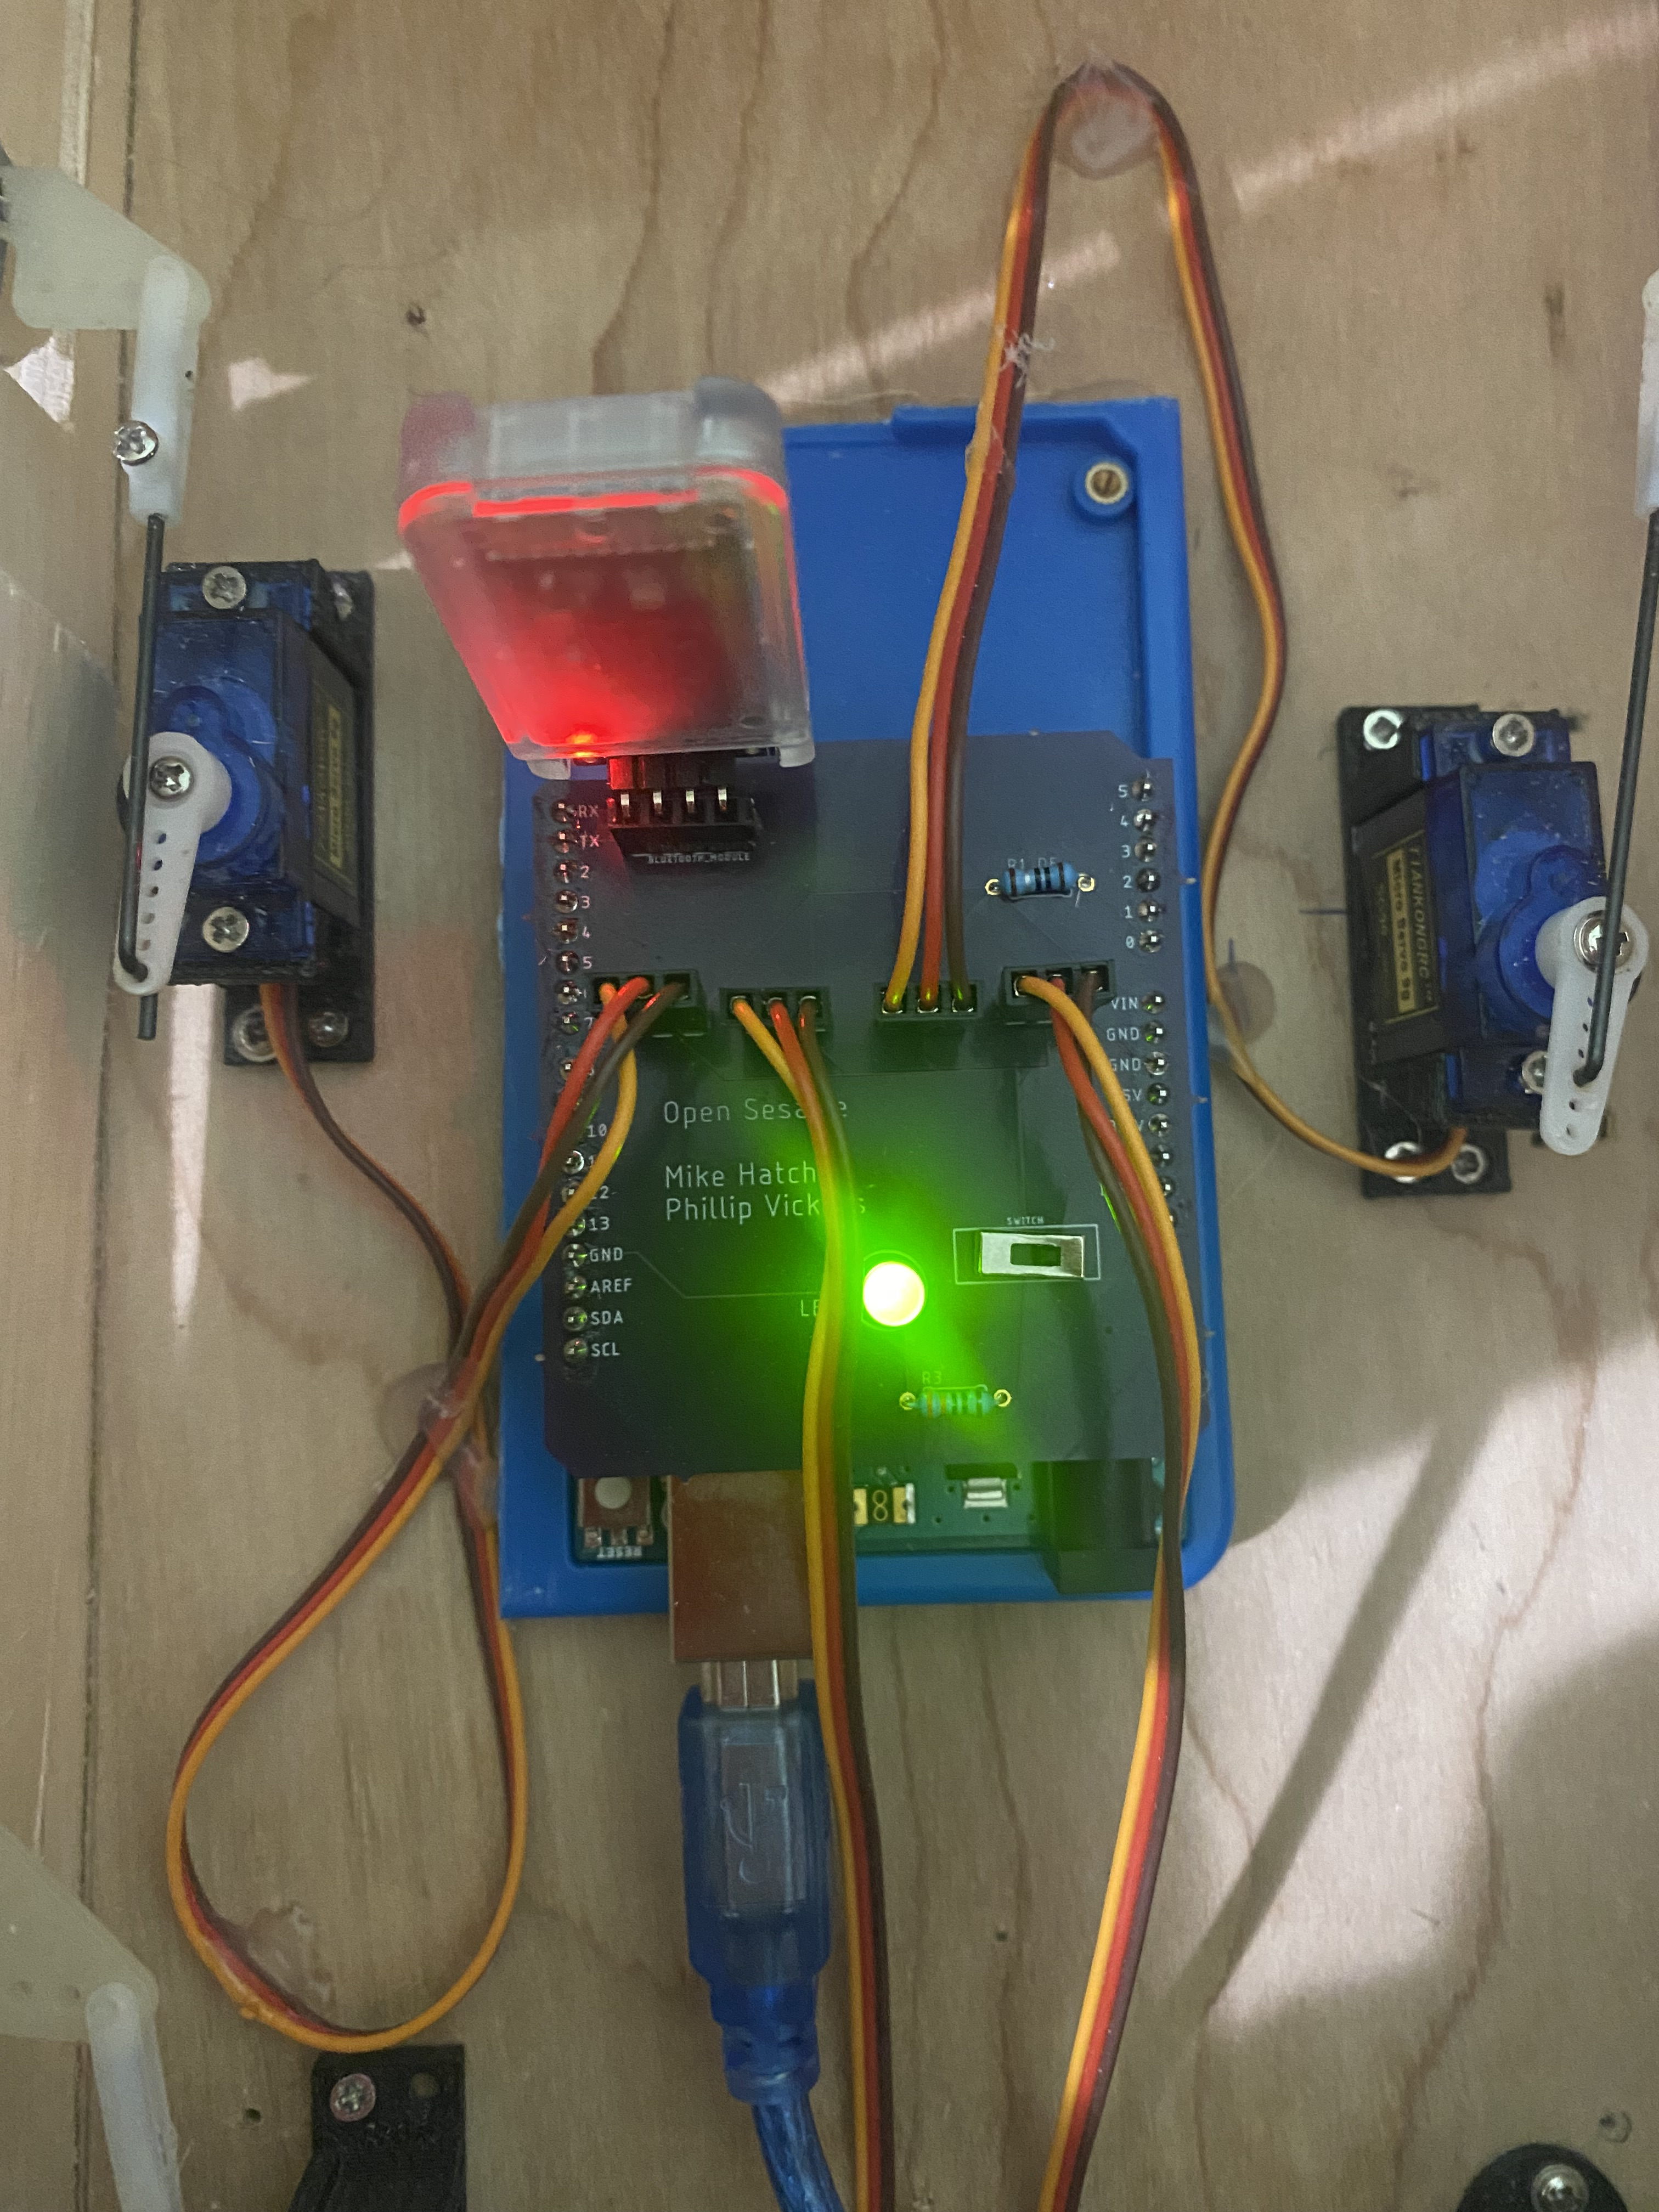
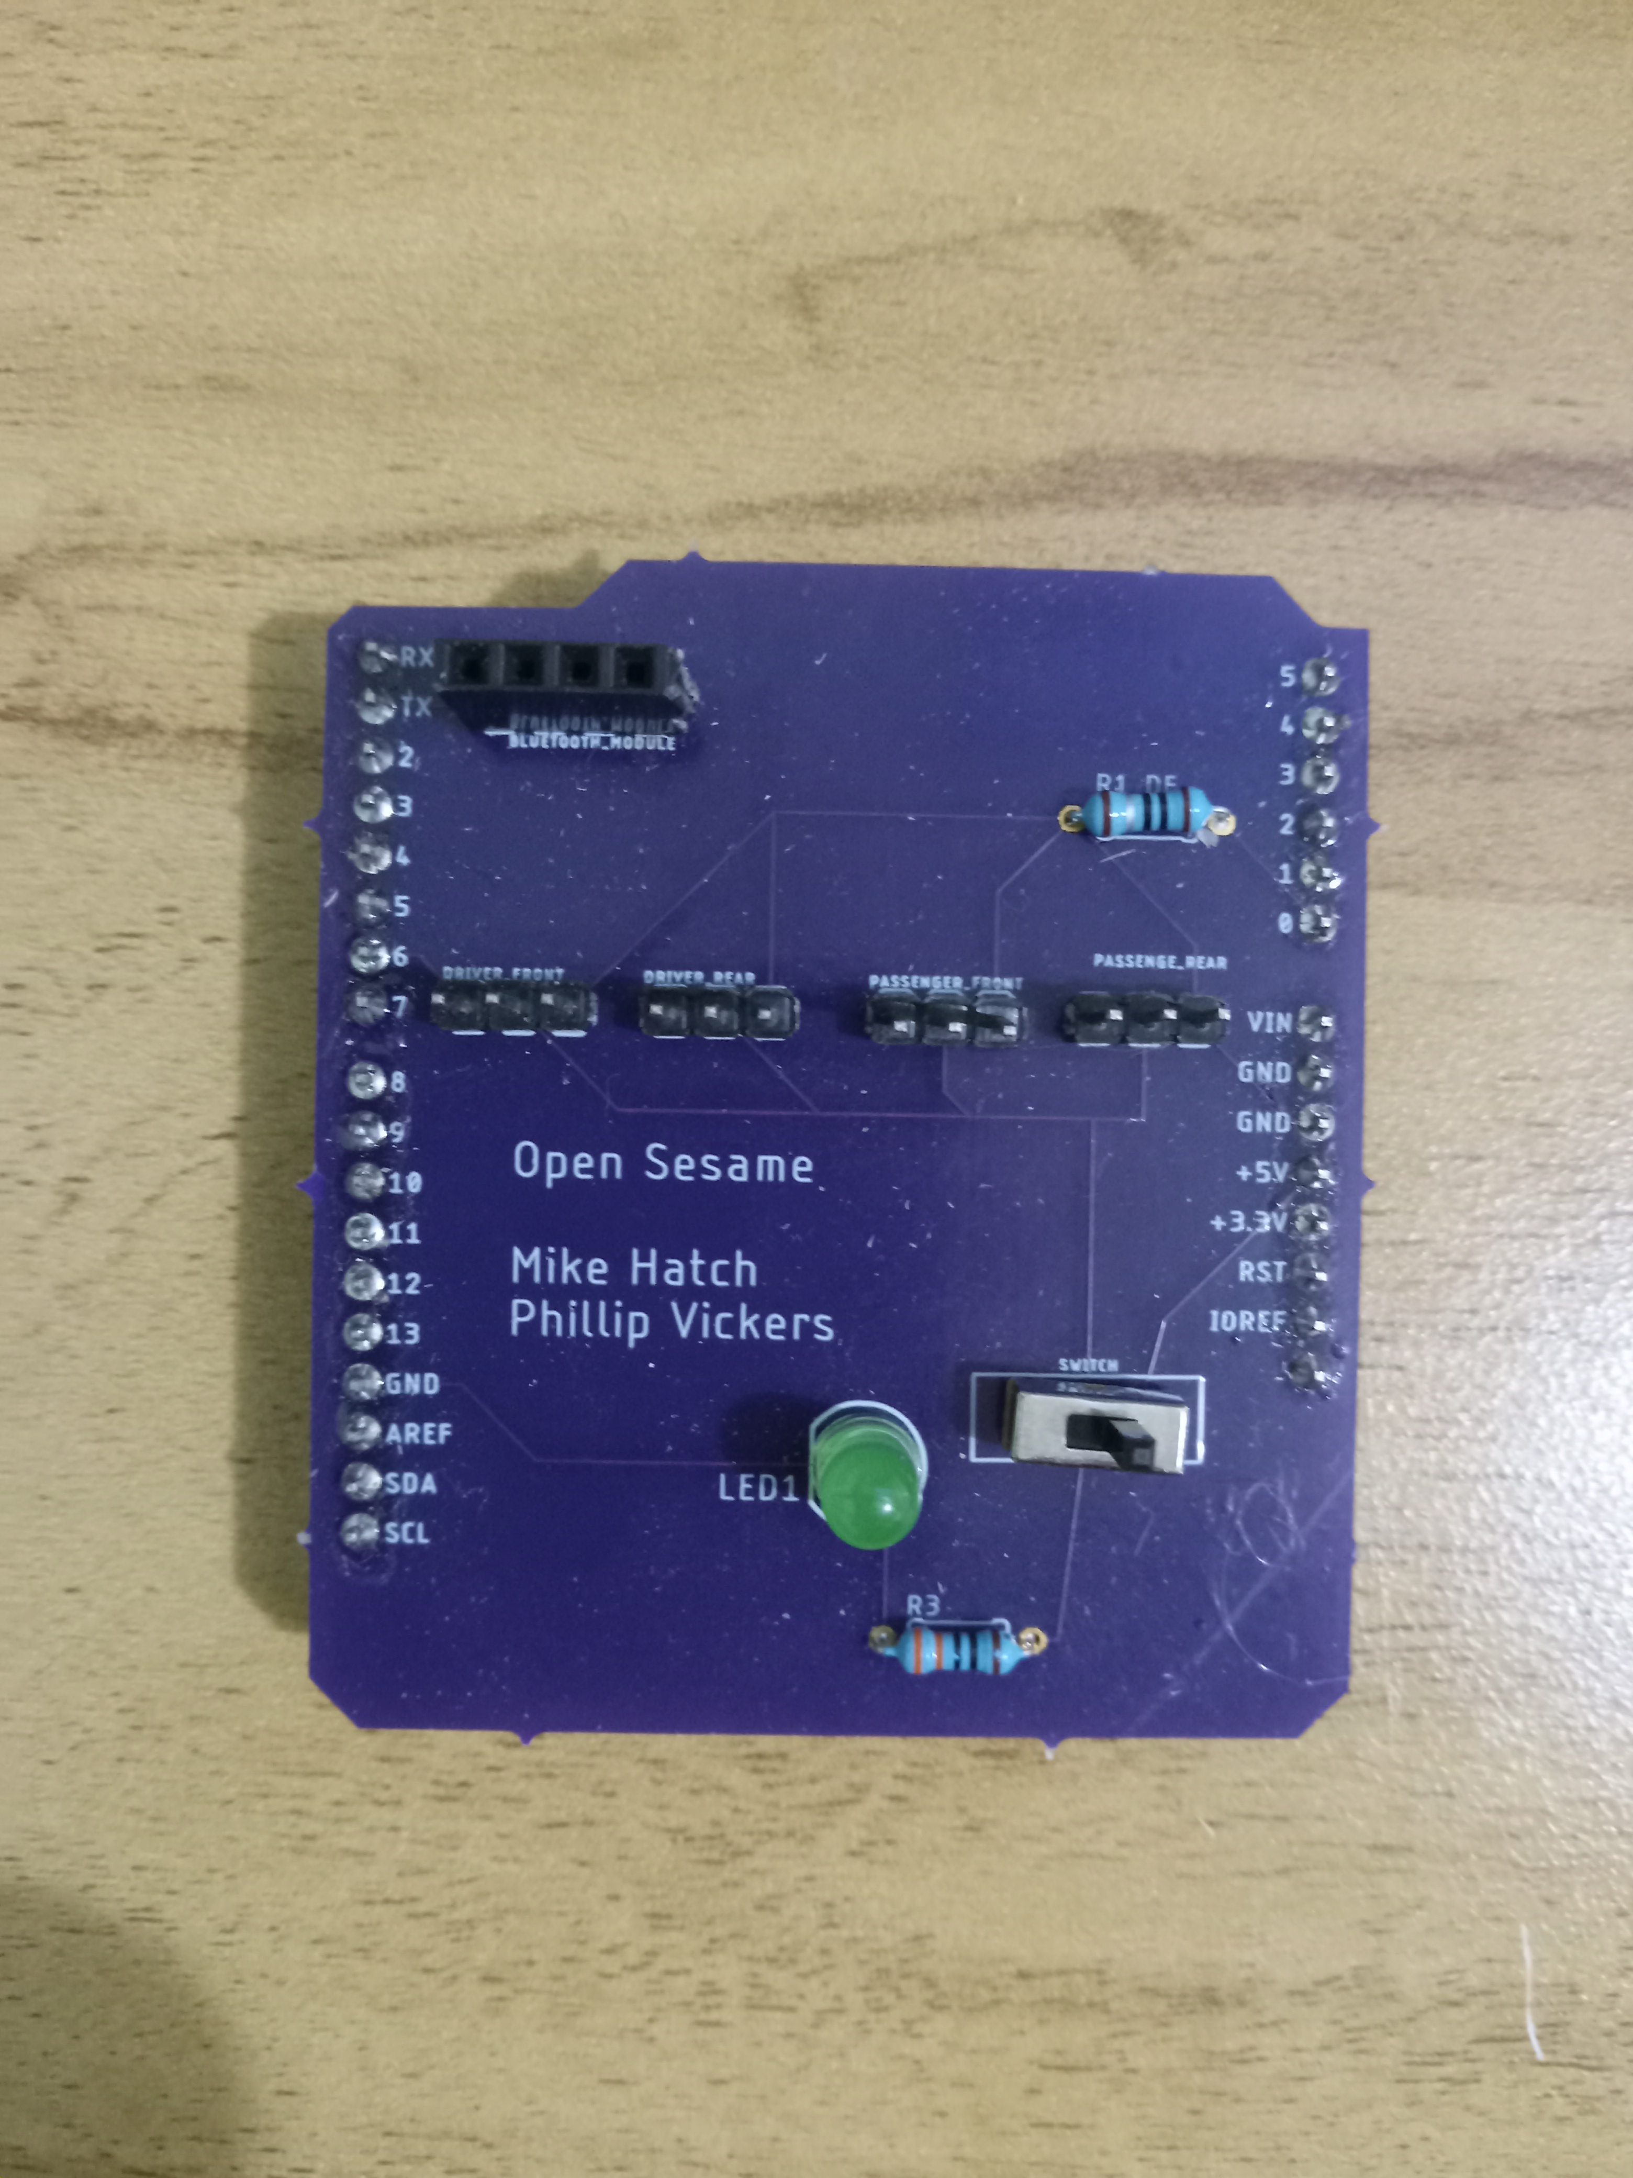
Custom PCB Shield Board Design
Schematic
Circuit Board

Slide 10
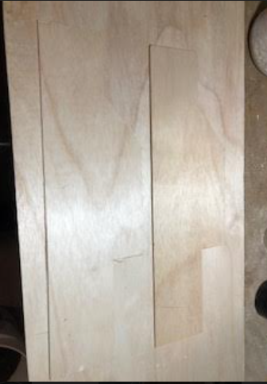
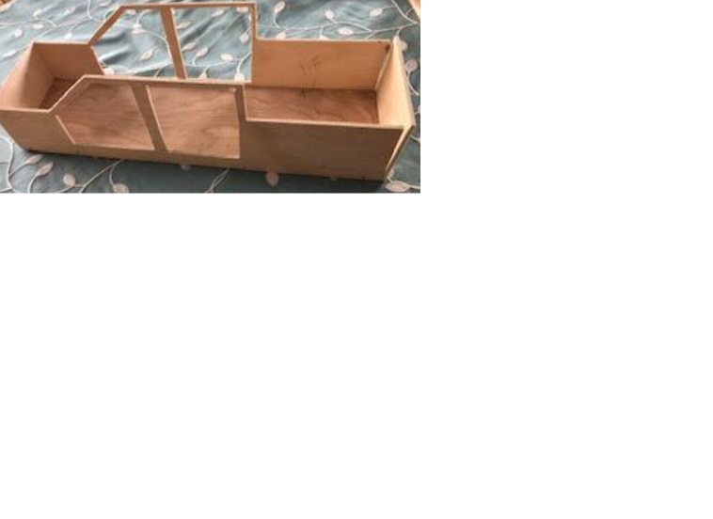
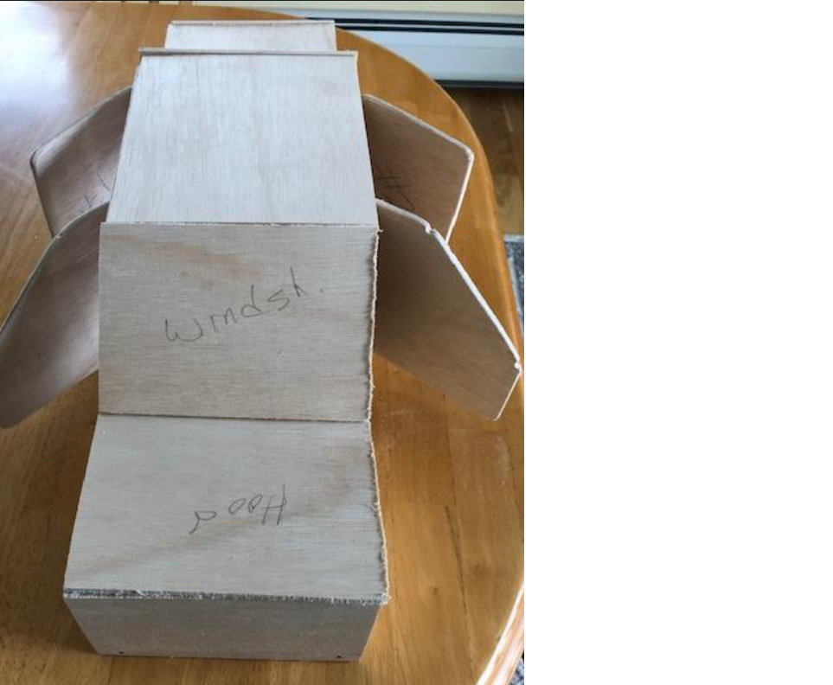
Prototype Creation
One challenge was finding a proto-type vehicle that would fit our components. We created one from scratch.

Slide 11
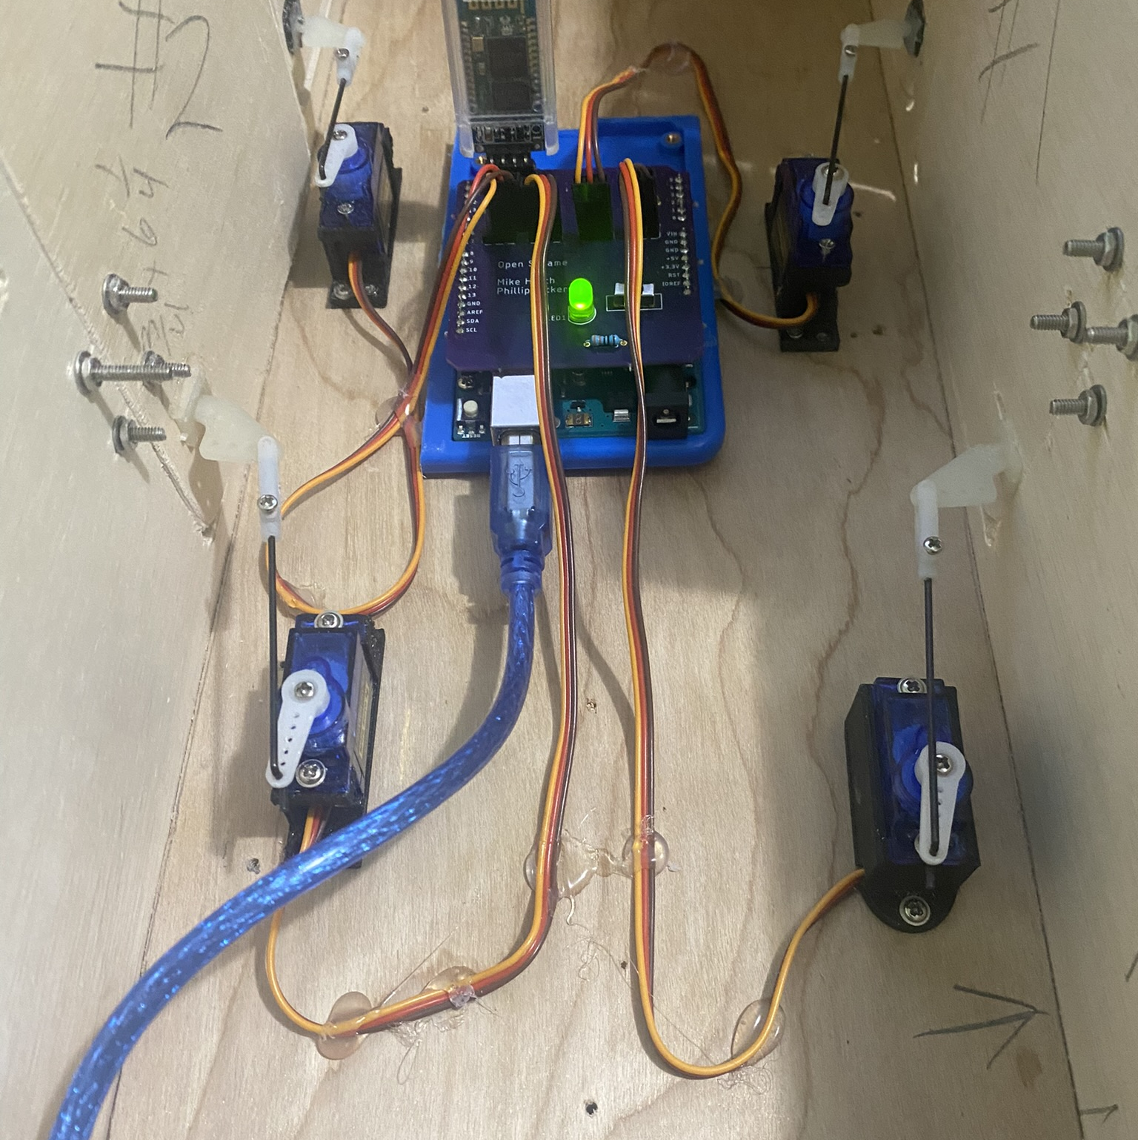
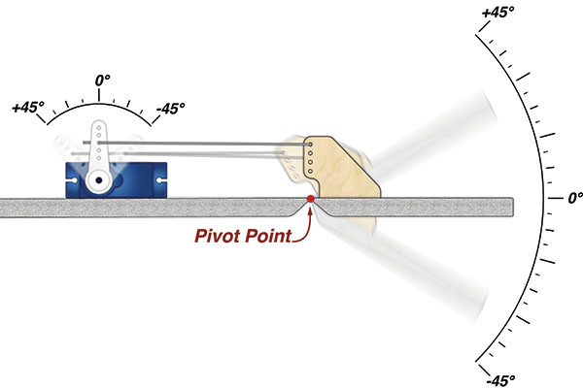
Prototype Creation
Door opening/ closing system
Internals of prototype

Slide 12
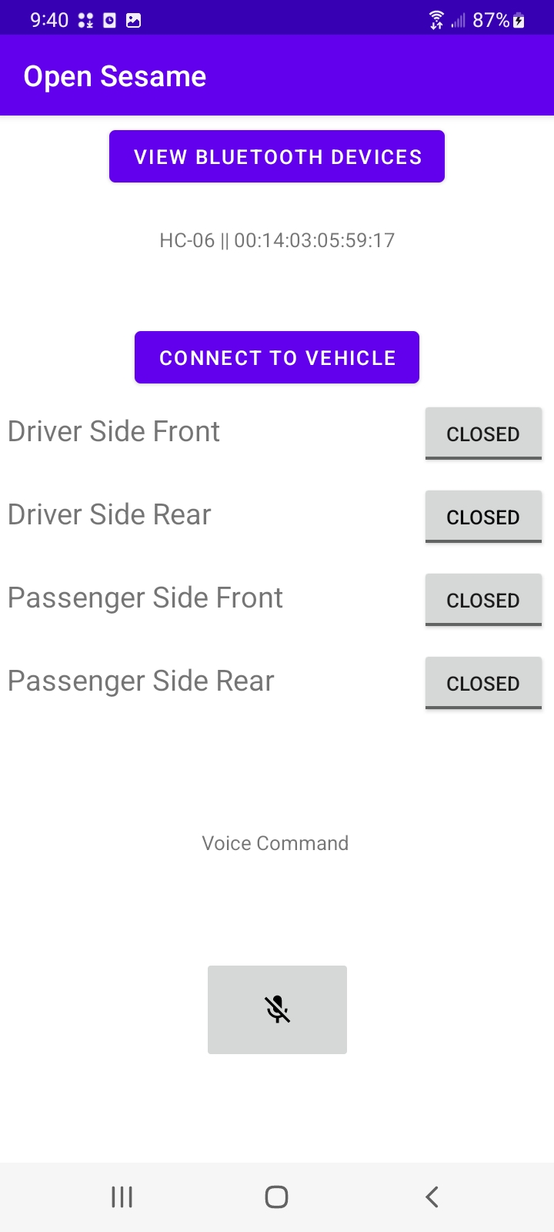
Mobile App
App written in Java
Makes use of Android SpeechRecognizer and Bluetooth APIs
Able to view paired BT devices and connect to vehicle
Can actuate door with toggle buttons or voice commands

Slide 13
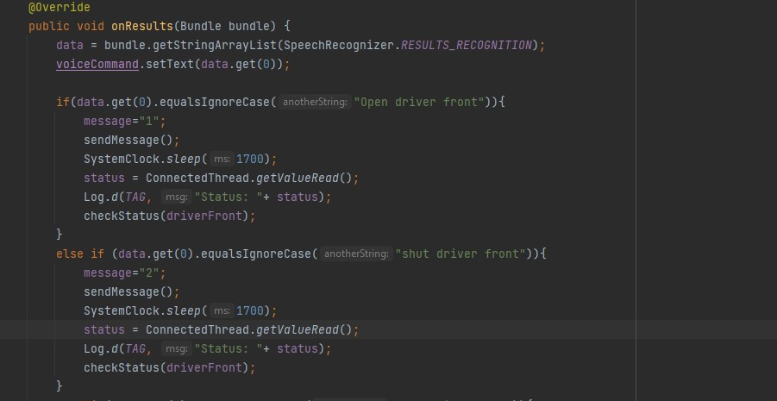
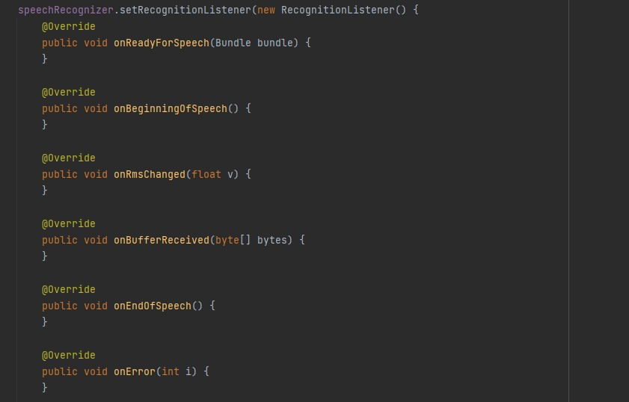
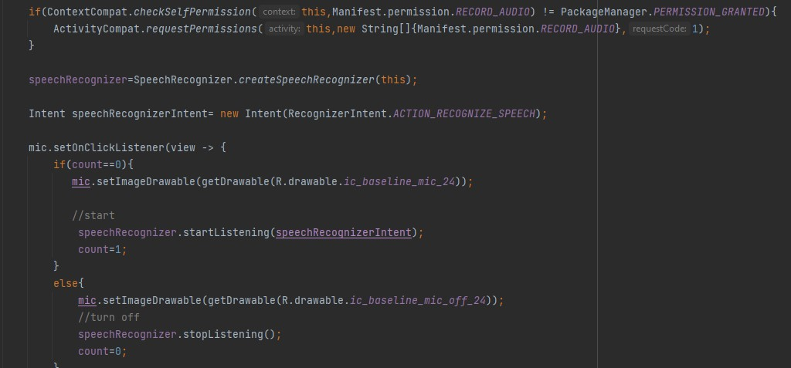
Speech Recognition

Slide 14
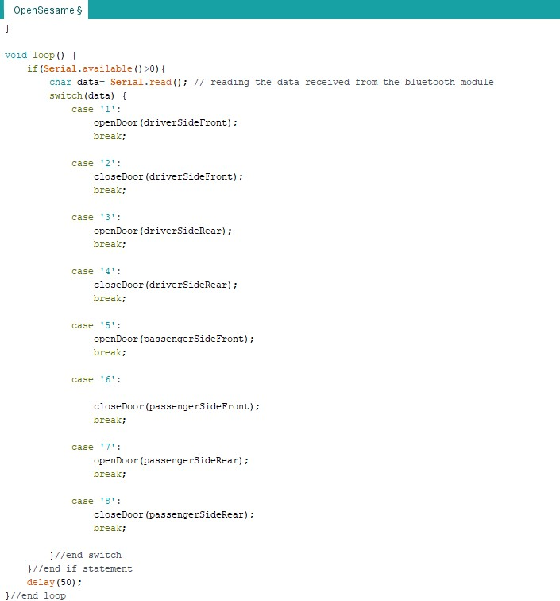
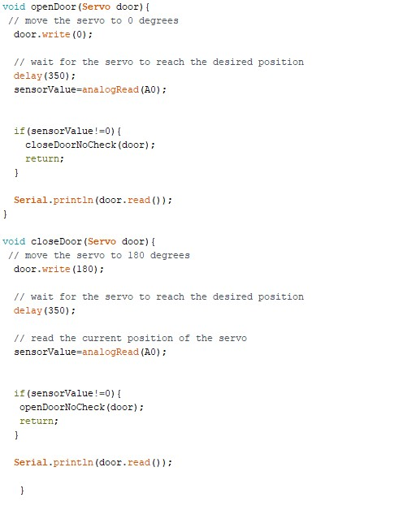
Arduino Firmware
Handles the opening/closing of doors.
Checks for obstructions.
Sends confirmation to mobile app

Slide 15
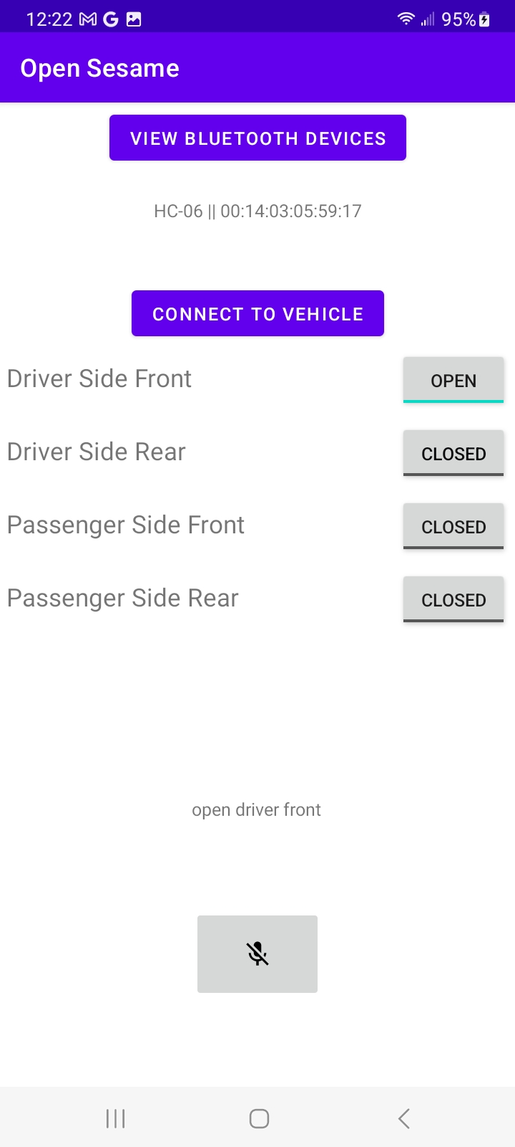
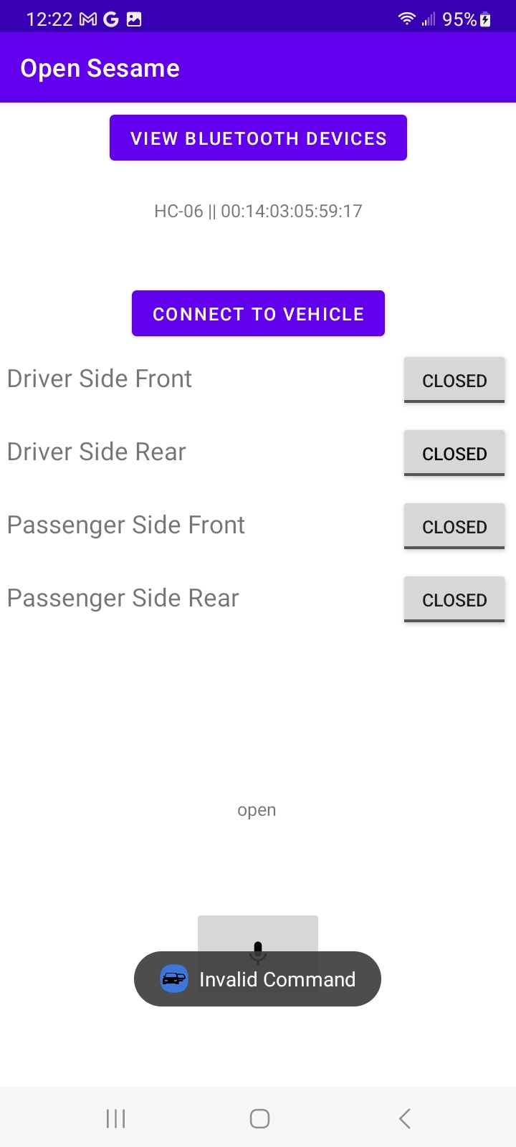
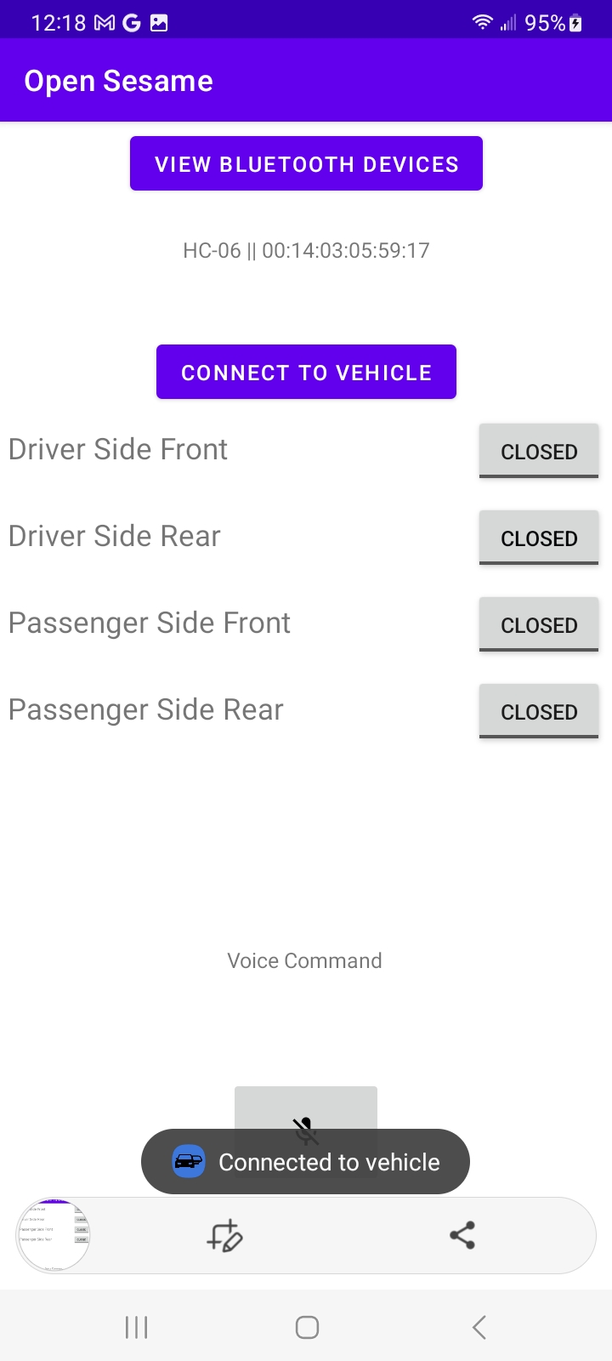
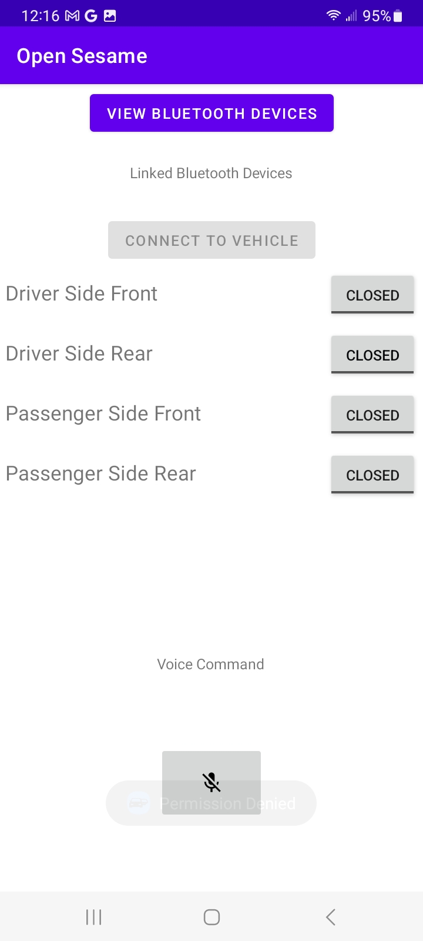
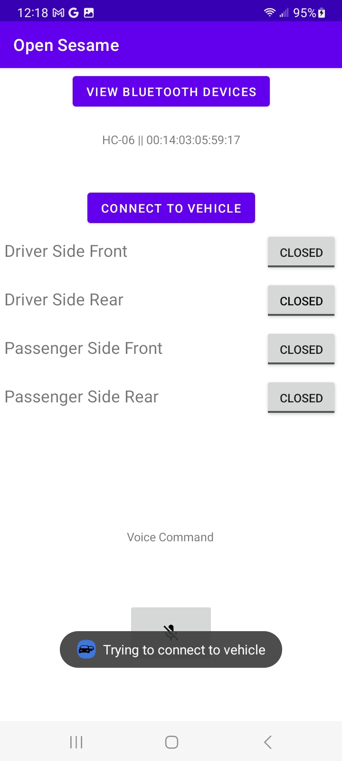
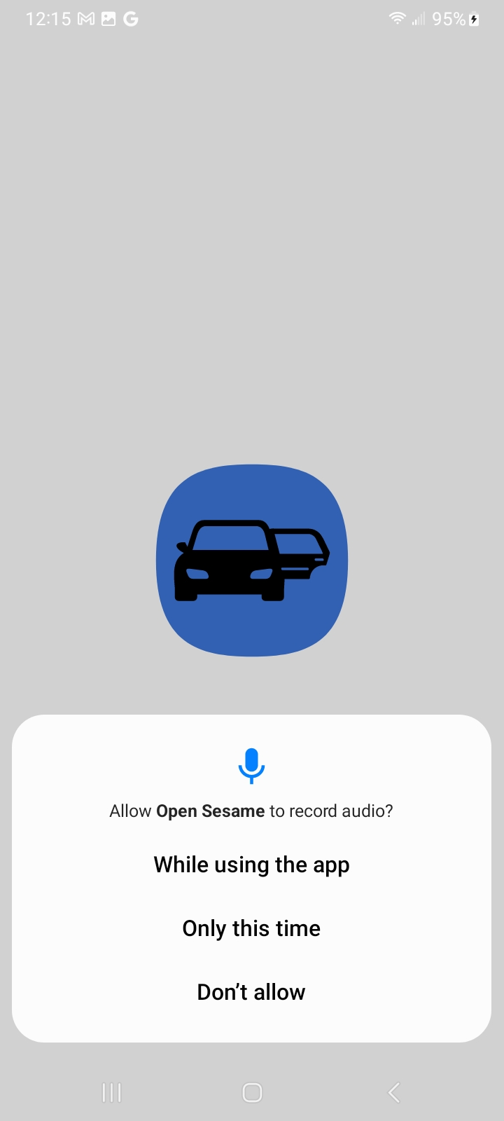
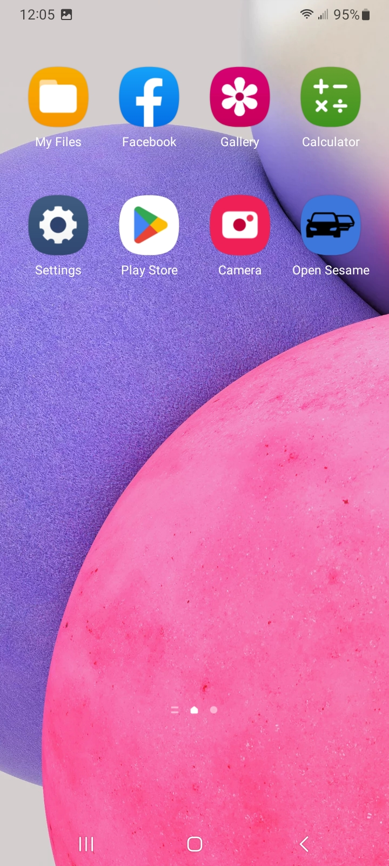

Mobile App

Slide 16

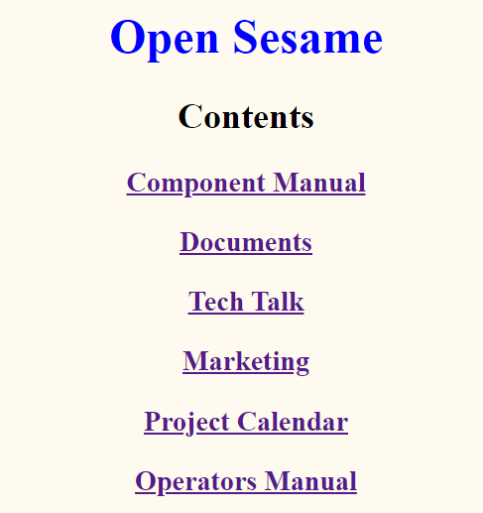
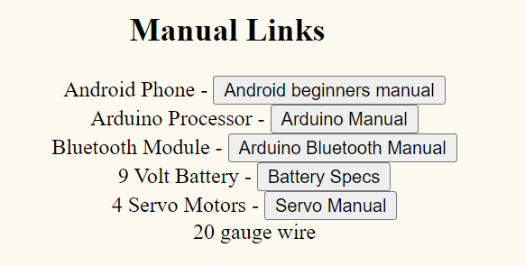
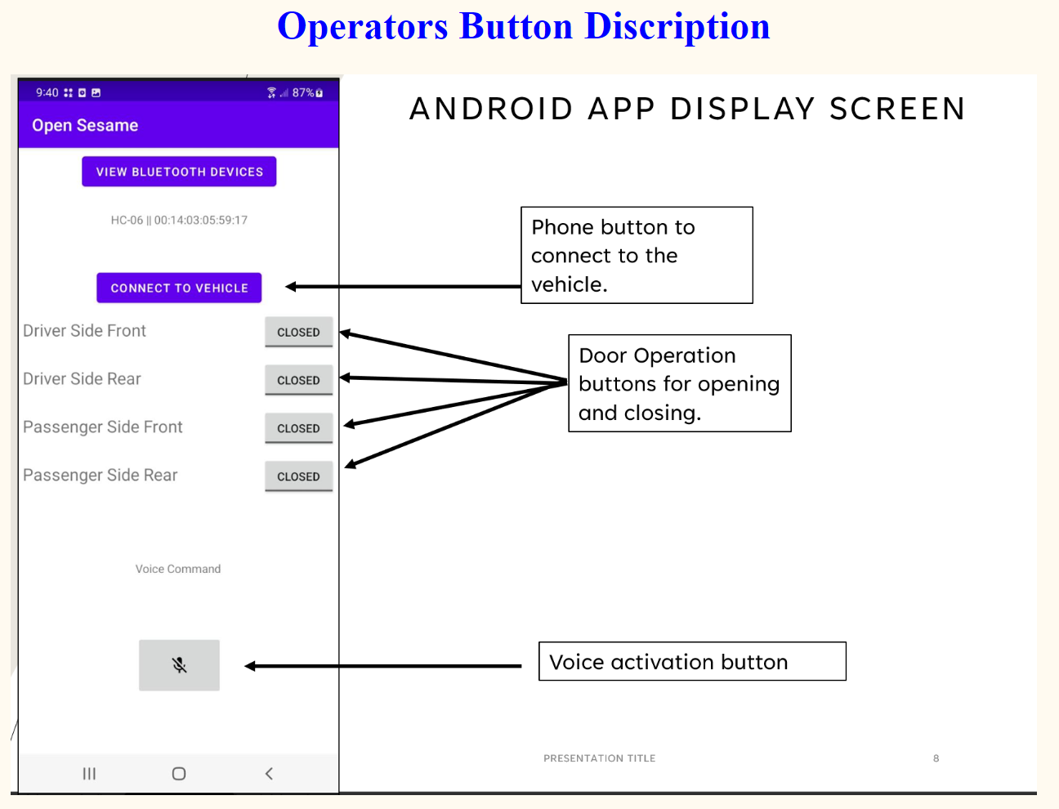
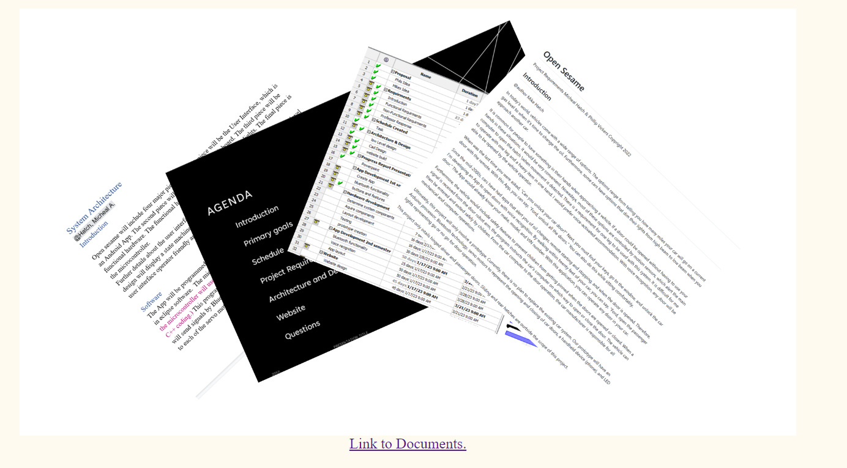
Website http://lemuria.cis.vtc.edu/~mhatch/

Slide 17
Live Demonstration

